Slide 1

Process Mining Virtual InternShip
by
Y.HARSHAVARDHAN LOURDUREDDY
224G5A3206
Department of Computer Science and Engineering (Data Science)
Srinivasa Ramanujan Institute of Technology
(Affiliated to JNTUA & Approved by AICTE) (Accredited by NAAC with ‘A’ Grade & Accredited by NBA (EEE, ECE & CSE)
Rotarypuram Village, B K Samudram Mandal, Ananthapuramu – 515701.
2023 - 2024

Slide 2

Contents
Course Objective
Introduction
Technology
Applications
Modules
Real Time applications
Learning Outcomes
GitHub Link
Queries

Slide 3
Course Objective
The primary objective of the course is to ensure that students gain a solid understanding of the fundamental concepts, principles, and methodologies of process mining.
The second main objective is to enable students to apply their acquired knowledge to real-world scenarios and datasets
Process mining validates how a system works on certain plan.
Process mining explains plan of action and how decisions are taking in a system.

Slide 4
Introduction
Process mining supports data science to discover, validate and improve workflow or plan of action in a system.
It is a data analysis technique that helps you understand how your business processes work. Extricating information from event logs can help you identify bottlenecks and improvement opportunities.
Process mining is specifically focused on analyzing and optimizing business processes within an organization.

Slide 5
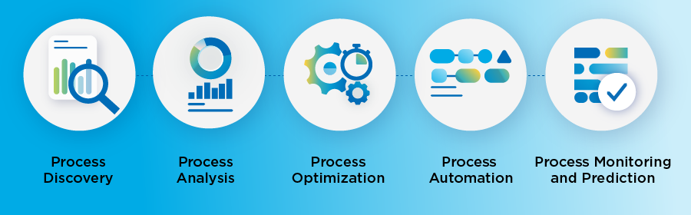
Process Mining Steps
Process discovery
Process discovery is now a simple and speedy part of rapid workflows, used to analyze desktop user interaction data and link it with process details mined from system event data. Using these timestamps, the software can then create visual models to help identify the variations and bottlenecks impacting efficiency or customer experience.
Process analysis
This is also the stage where you can better understand your processes by visualizing them through process mapping

Slide 6
Process Mining Steps
Process optimization
Using the data you’ve gathered in the discovery and analysis phases, you can now make changes to your processes to prepare them for automation
Process automation
At this stage, your process data can be exported for RPA. With insights gained in previous steps, you can choose the ‘happy path’ with the least resistance and highest ROI for automation.
Process monitoring & prediction
Some process mining solutions will monitor every process instance. This is usually only available with full process intelligence. The platform will issue alerts or automatically act when unusual process behavior occurs.

Slide 7
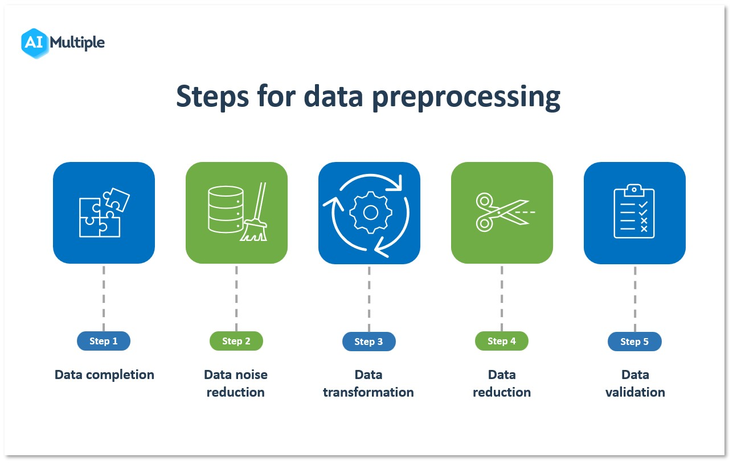
Technology
Data preprocessing
Data preprocessing is an important step in the process mining. It refers to the cleaning, transforming, and integrating of data in order to make it ready for analysis. The goal of data preprocessing is to improve the quality of the data.

Slide 8
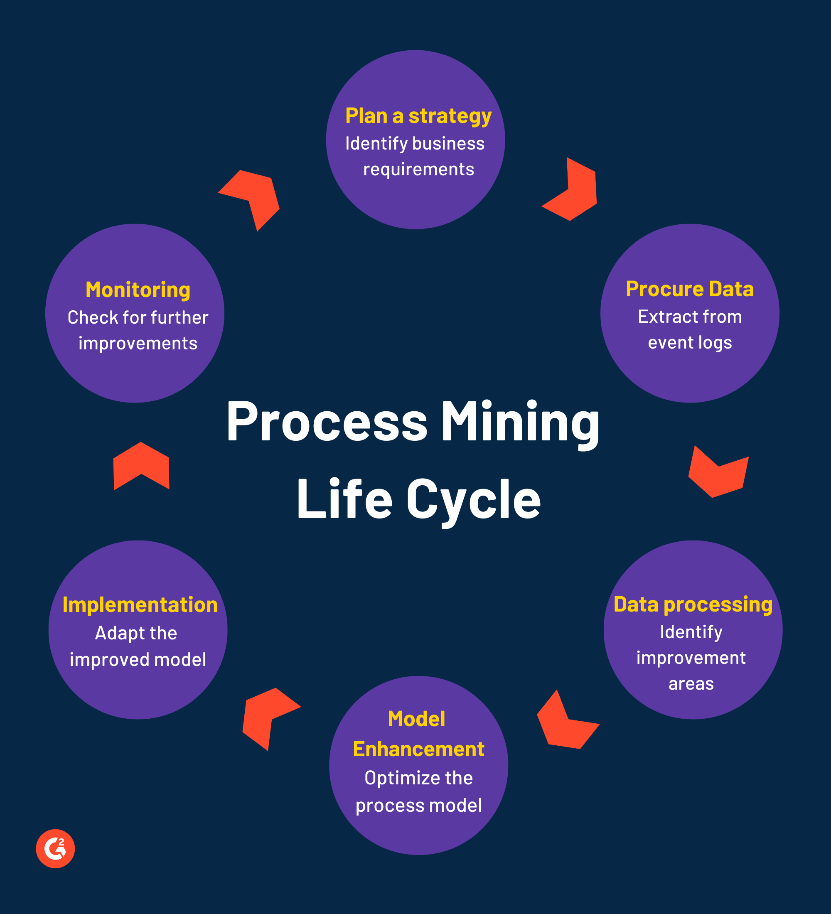
Modules
Modules involved in process mining are
1.Plan a strategy
2.Procure Data
3.Data Processing
4.Model Enhancement
5.Implementation
6.Monitoring

Slide 9
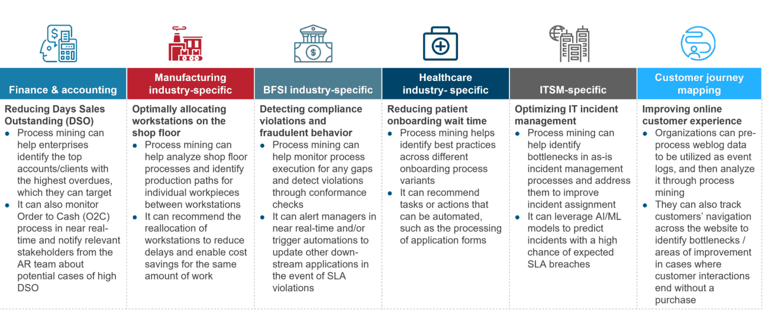
Applications
Finance & Accounting
Manufacturing Industry
BFSI Industry
Healthcare Industry
ITSM

Slide 10
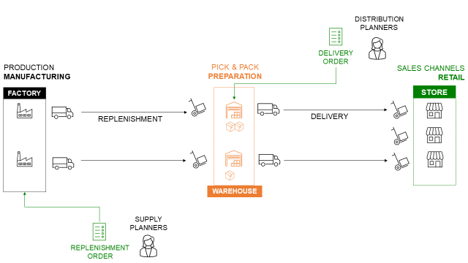
Real Time Applications
It aims to provide insights into how processes are actually being executed, identify inefficiencies, bottlenecks, and deviations from the expected workflow, and ultimately improve the overall operational efficiency and effectiveness of a production system.

Slide 11

Real Time Applications
Process mining in logistics aims to optimize logistics operational efficiency and improve customer experience.
It identify problems like late deliveries and their root causes to prevent possible supply chain distribution.

Slide 12
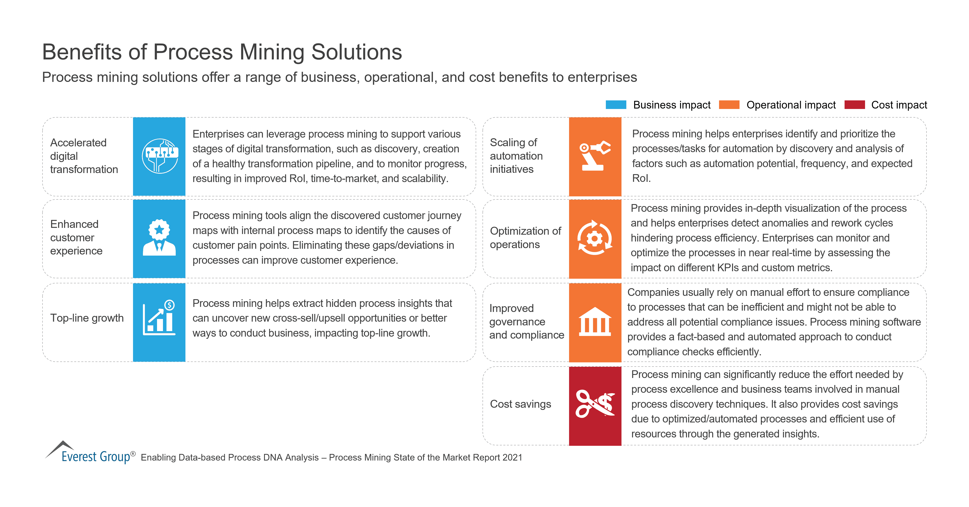
Benefits of Process Mining

Slide 13
Learning Outcomes
We’ll learn how various business processes works within an organisation like process flow, decision points.
We’ll learn how to clean, preprocess and analyze the data to extract meaningful insights and identify patterns.
We’ll learn how to work with process mining tools and softwares.
We’ll address the issues whether they are related to work flow design or resource allocation in process mining.

Slide 14
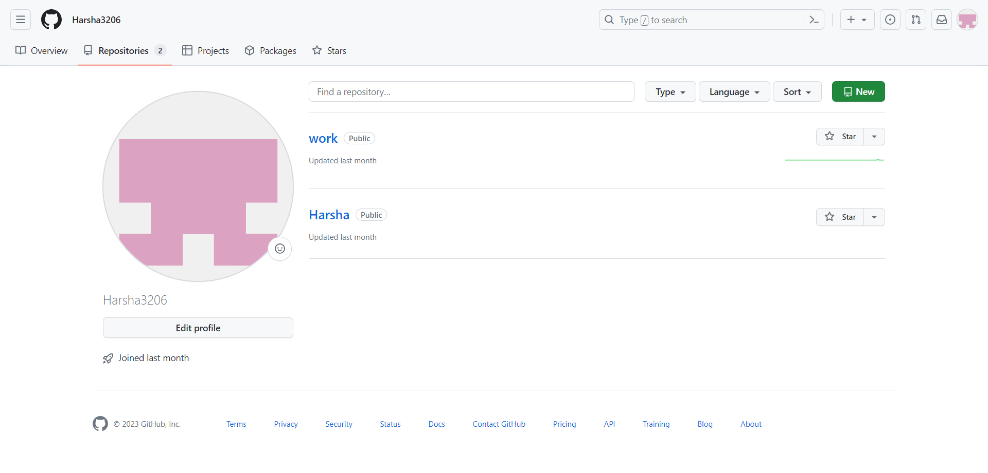
GitHub Dashboard
GitHub Link : https://github.com/Harsha3206

Slide 15
Any Queries?

Slide 16
Thank You!!!

